Slide 1
Bencare insurance company
Saral Joshi & Yuanyuan Tong

Slide 2
Business problem
Bencare has been losing loyal customers to its competitors in recent times. 5 key variables were identified by management to better understand customer base and a survey was conducted. Post data collection, It is necessary for Bencare to analyze if these key variables are effective in addressing business needs in terms of how customers view the company, its products, and company-customer relationship.

Slide 3
Data set & aSSUMPTIONS -Basic description
The dataset contains 39 variables. Analyzing 25 variables Assumed data has 5 underlying factors identified by management. 1. Customer’s Trust in the Company Representative (Rep17 to Rep 20) 2. Customer’s Trust in the Company (Prac17 to Prac20) 3. Customer Satisfaction with Company products (Inter1 to Inter3) 4. Customer’s Value (benefits relative to costs) Assessment (Val1 to Val6) 5. Customer Loyalty (Loy1 to Loy8)
Standard deviation of all variables is greater than 1 and similar.
Variables have skewed distribution but Data set is large enough to run factor analysis, assuming weak normality very few missing values
Further discussion on normality and scaling has been discussed at the end of the presentation
Example: Customer Loyalty Survey Result

Slide 4
BEST Results
Sampling adequacy of 0.958 is a very good indicator that our model is good, since it is above 0.9. Anti-image correlation matrix also gave good results for individual variables.
KMO and Bartlett's Test
Kaiser-Meyer-Olkin Measure of Sampling Adequacy. |  | 0.958
Bartlett's Test of Sphericity | Approx. Chi-Square | 27096.924
 | df | 253
 | Sig. | 0.000
Total Variance Explained
Factor | Initial Eigenvalues |  |  | Extraction Sums of Squared Loadings |  |  | Rotation Sums of Squared Loading
 | Total | % of Variance | Cumulative % | Total | % of Variance | Cumulative % | Total
1 | 15.474 | 67.279 | 67.279 | 15.349 | 66.734 | 66.734 | 13.136
2 | 1.584 | 6.889 | 74.168 | 1.332 | 5.792 | 72.526 | 10.451
3 | 1.336 | 5.808 | 79.977 | 1.205 | 5.241 | 77.767 | 11.333
4 | 0.806 | 3.505 | 83.482 | 0.707 | 3.074 | 80.841 | 11.632
5 | 0.684 | 2.972 | 86.454 | 0.506 | 2.202 | 83.043 | 12.077
In the case, for Eigen values>1, the total variance explained is less, i.e. 77%, we can go up to 83% by setting the selection criteria to Eigen Values>0.7. This threshold is known as the Joliffe criteria.
Therefore, we get 5 factors for further analysis.

Slide 5
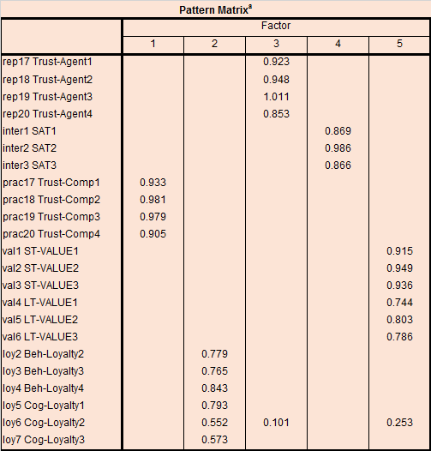

BEST Result
This model coincides with the managements idea that the survey can be factored in 5 key variables Factor 1 can be explained by Customer’s Trust in the Company
Factor 2 can be explained by Customer Loyalty
Factor 3 can be explained by Customer’s Trust in the Company Representative
Factor 4 can be explained by Customer Satisfaction with Company product
Factor 5 can be explained by Customer’s Value (benefits relative to costs) Assessment
Notes : Removed Cog-loy4 & Beh-loy1 variable FACTOR METHOD – PRINCIPAL AXIS FACTORING ROTATION – OBLIMIN WITH KAISER NORMALIZATION

Slide 6
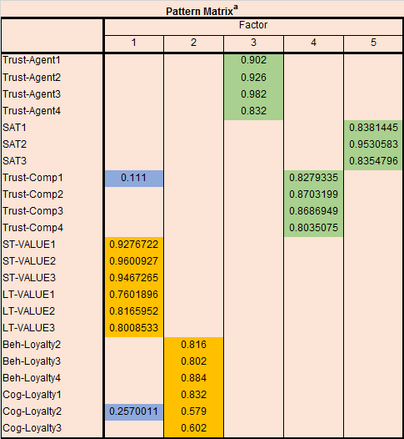
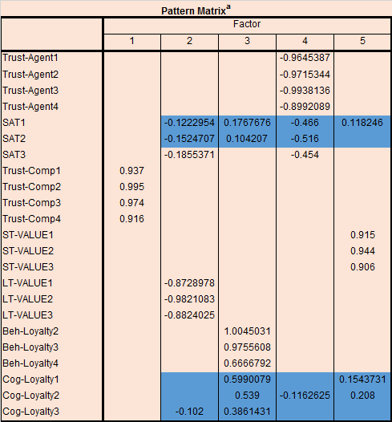

COMPARISON WITH OTHER METHODS
MAXIMUM LIKELIHOOD
PAF WITH PROMAX ROTATION
Overall, loading is lower in 3 factors, and higher in 2 factors. Hence Oblimin with PAF has been preferred. Also cross loading is on one variable with Oblimin vs 2 in Promax.
With Maximum Likelihood there is a clear problem of cross loading between factors

Slide 7
Using the factors
Hypothesis : Mean values of factors differentiated by segments based on demographics is same (ANOVA null hypothesis)
We test one case here, by education
ANOVA
 |  | Sum of Squares | df | Mean Square | F | Sig.
Trust in company | Between Groups | 18.443 | 5 | 3.689 | 3.816 | 0.002
 | Within Groups | 743.287 | 769 | 0.967
 | Total | 761.730 | 774
Customer loyalty | Between Groups | 40.714 | 5 | 8.143 | 9.341 | 0.000
 | Within Groups | 670.390 | 769 | 0.872
 | Total | 711.105 | 774
Trust in Rep | Between Groups | 23.779 | 5 | 4.756 | 4.977 | 0.000
 | Within Groups | 734.875 | 769 | 0.956
 | Total | 758.654 | 774
Customer Satisfaction | Between Groups | 21.013 | 5 | 4.203 | 4.418 | 0.001
 | Within Groups | 731.426 | 769 | 0.951
 | Total | 752.439 | 774
VAlue Assesment | Between Groups | 16.292 | 5 | 3.258 | 3.408 | 0.005
 | Within Groups | 735.248 | 769 | 0.956
 | Total | 751.540 | 774
All p<0.05 Null hypothesis is rejected for all factors, on basis of education level. Which means that these 5 variables show different mean value based on Level of education

Slide 8
CONCLUSION
The managerial view of 5 key variables is effective since it gives 5 clear factors with significant loading.
Different methods yield different results and PAF with Oblimin rotation has yielded the best results in this case with 5 factors
The factors were used to perform a one-way ANOVA test, where it emerged that mean values of factors for different segments based on education is different.

Slide 9
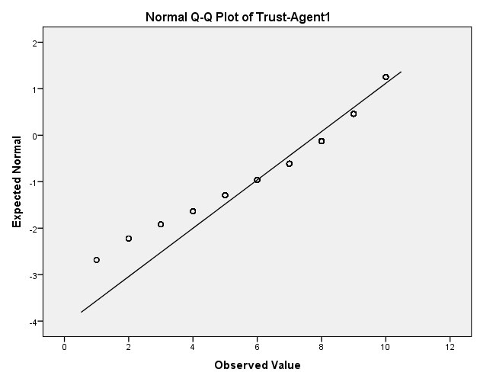
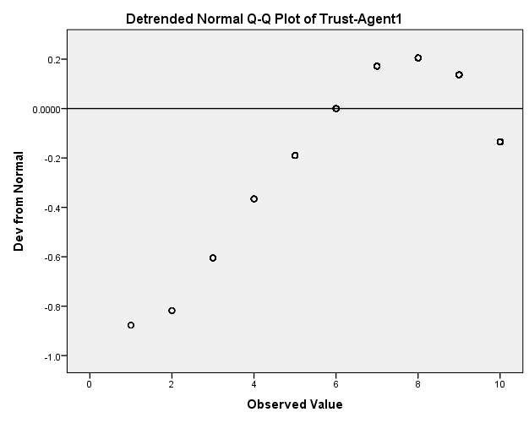
APPENDIX -Normality & Scaling
Normality
The first step in factor analysis is to determine whether given variables have a normal distribution.
In all, 23 variables have skewness greater than -1.0, but some still have high skewness (-0.8 to -0.9).
Q-Q plot shows the distribution is left skewed and similar results for other variables except Price Variables and Reputation variables.
QQ Plot for Trust-Agent 1

Slide 10
APPENDIX -Normality & Scaling
Scaling
There are two different scales used in the questionnaire, 1-10 and 1-7. However, we do not need to standardize variables scales since SPPS by default uses correlation matrix which is standardized.
Since our data is mostly non-normal, we choose Principal Axis Factoring (PAF) as it takes non – normality into account.

